Slide 1
Comparison of MapReduce & Apache Spark
Gihari Epage - 248221G

Slide 2
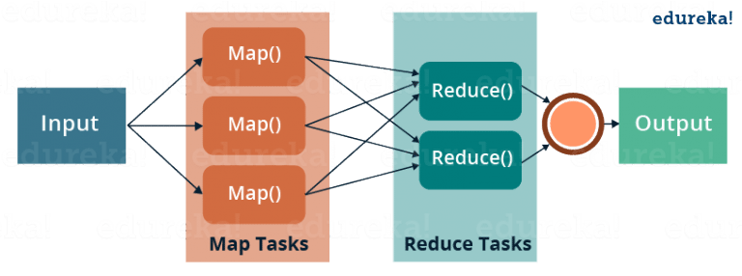
What is MapReduce
MapReduce is a programming model used for efficient processing in parallel over large data-sets in a distributed manner

Slide 3
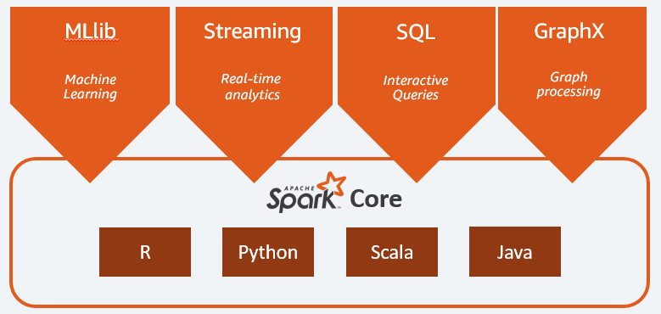
What is Apache Spark
Apache Spark is a distributed and computing data processing framework for big data analytics.
Inbuilt feature “in-memory” which increases the data processing speed to maintain a wide range of corporate workload

Slide 4
Demo

Slide 5
Results

Slide 6
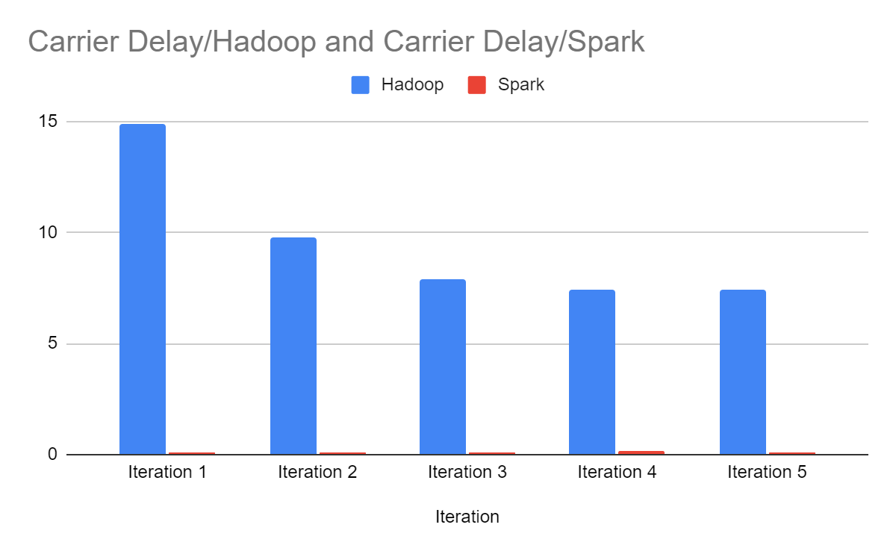
Query Execution Results – Carrier Delay

Slide 7
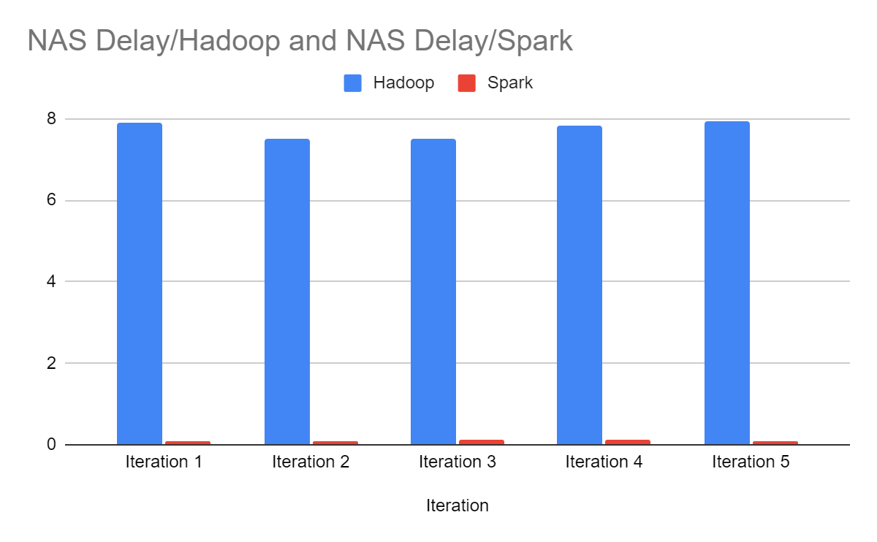
Query Execution Results – NAS Delay

Slide 8
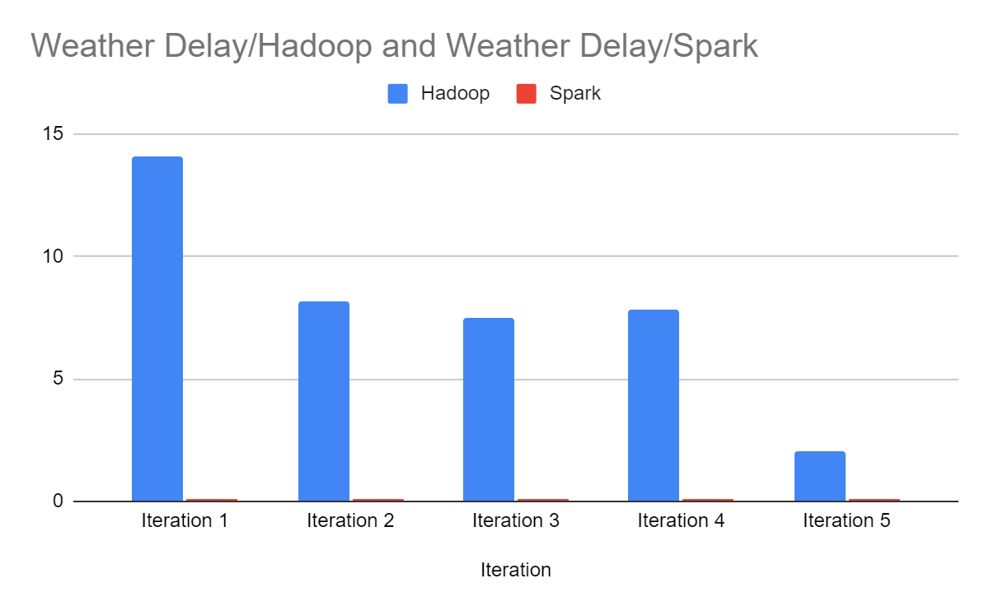
Query Execution Results – Weather Delay

Slide 9
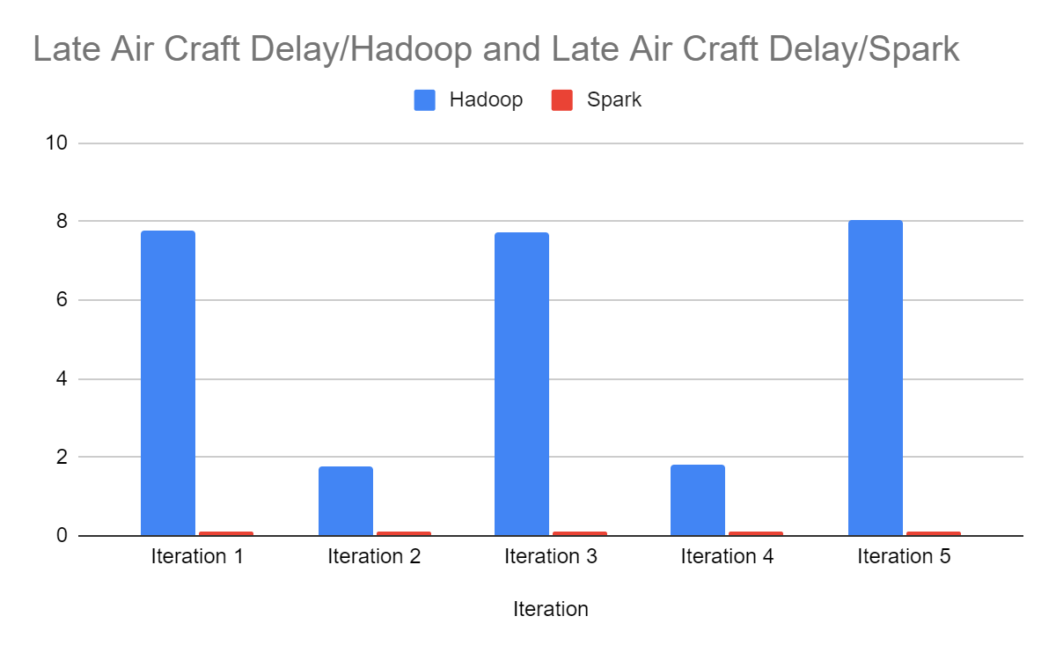
Query Execution Results – Aircraft Delay

Slide 10
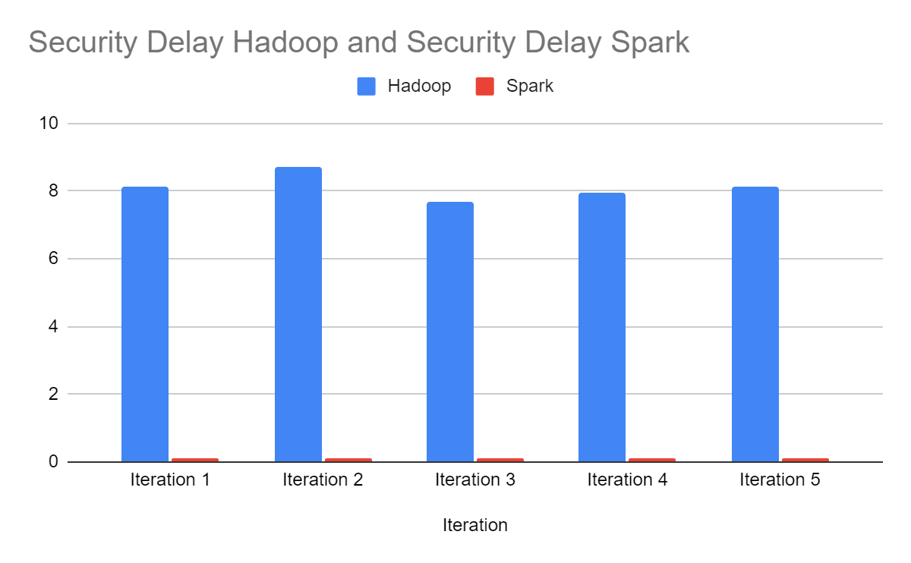
Query Execution Results – Security Delay

Slide 11
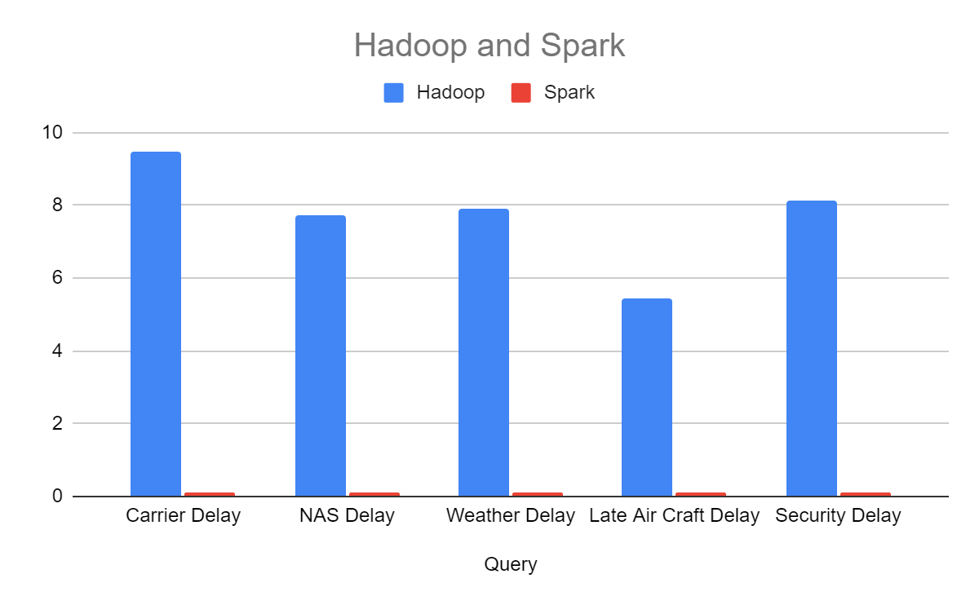
Query Execution Results – Hadoop vs Spark

Slide 12
Hadoop MapReduce vs Apache Spark
 | Hadoop MapReduce | Apache Spark
Performance | Generally slow as it performs operations on the disk. Cannot deliver near real-time analytics from the data. | Runs x100 faster in-memory and x10 faster on disk. If spark runs on YARN with other resource demanding services, can be degradations
Ease of Use | Complex to use has there is no interactive mode and need to handle low level APIs to process the data. | Supports user-friendly APIs for different languages and has interactive mode and provide feedback for queries and actions

Slide 13
Thank You!

